Slide 1

🎯 CUSTOMER SEGMENTATION & BEHAVIOR ANALYSIS A Data-Driven Approach Using Clustering and Regression
👤 Spoorthi
(3043NUQT)
📊 ADS -02
🔗 GitHub Repository:
https://github.com/spoorthihs4-ops/APPLIED-DATA-SCIENCE
This Photo by Unknown Author is licensed under CC BY-SA-NC

Slide 2

Introduction & Dataset Overview UNDERSTANDING CUSTOMER BEHAVIOR ⦁ Crucial for targeted marketing strategies ⦁ Uncover hidden spending patterns in data ⦁ Enable data-driven decision making DATASET: MARKETING CAMPAIGN • Source: Kaggle Dataset https://www.kaggle.com/datasets/imakash3011/customer-personality-analysis • 2,240 customers × 29 features

Slide 3
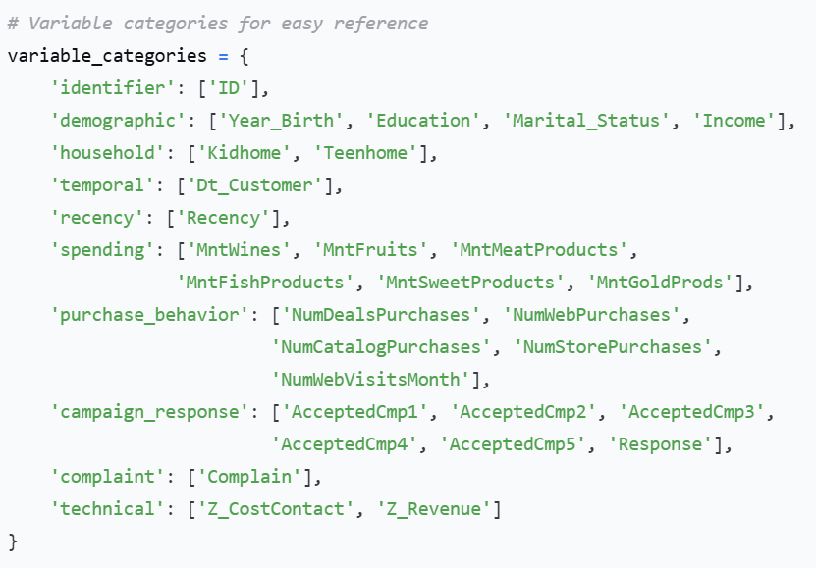
KEY VARIABLES :
KEY VARIABLES ANALYZED:
• **Demographics**: Income, Education, Marital Status
• **Spending**: MntWines, MntFruits, MntMeatProducts, MntFishProducts, MntSweetProducts, MntGoldProds
• **Purchases**: NumWebPurchases, NumCatalogPurchases, NumStorePurchases, NumDealsPurchases
• **Campaigns**: AcceptedCmp1-5, Response
• **Household**: Kidhome (No.of children in household), Teenhome (No of teenagers in household)

Slide 4
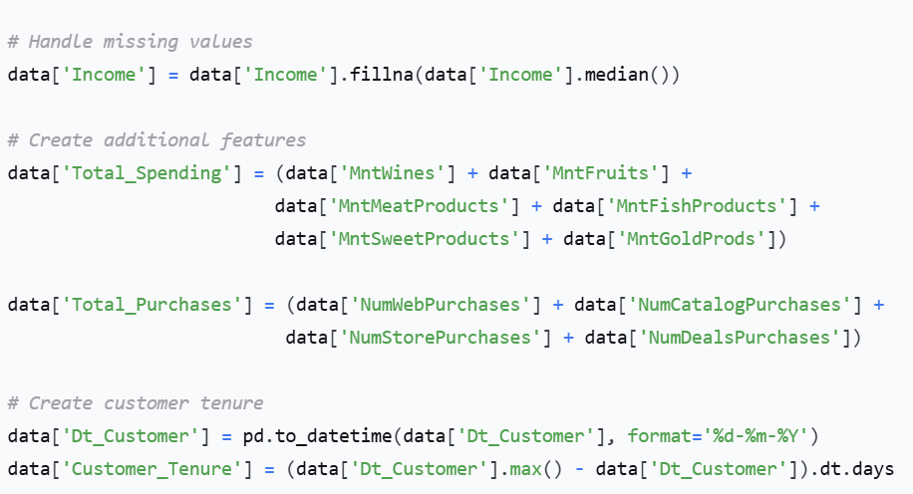
Data Preprocessing & Feature Engineering
KEY PREPROCESSING STEPS:
⦁ Handled Missing Values → Income median imputation
⦁ Feature Engineering → Total_Spending, Total_Purchases, Customer_Tenure
WHY THIS MATTERS: •Clean data = Reliable insights ⦁Engineered features = Foundation for advanced models

Slide 5
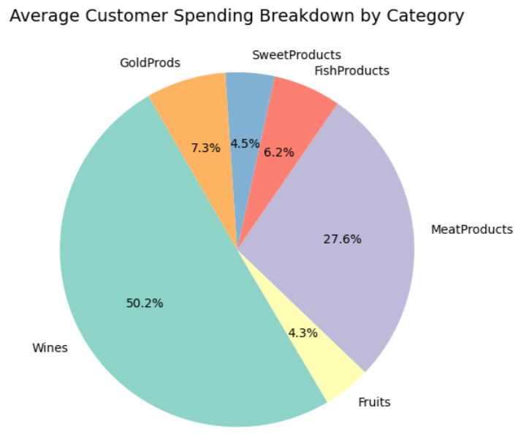
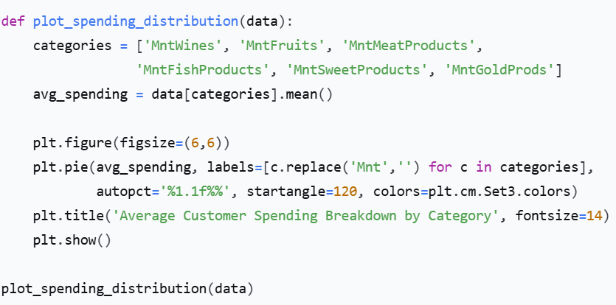
Plot 1: Customer Spending Breakdown
KEY FINDINGS: Wines and Meat Products DOMINATE portfolio
These two categories = Majority of total revenue
PRACTICAL INSIGHT: • Focus marketing on Wines & Meat as core revenue drivers • Confirms 80/20 rule in action

Slide 6
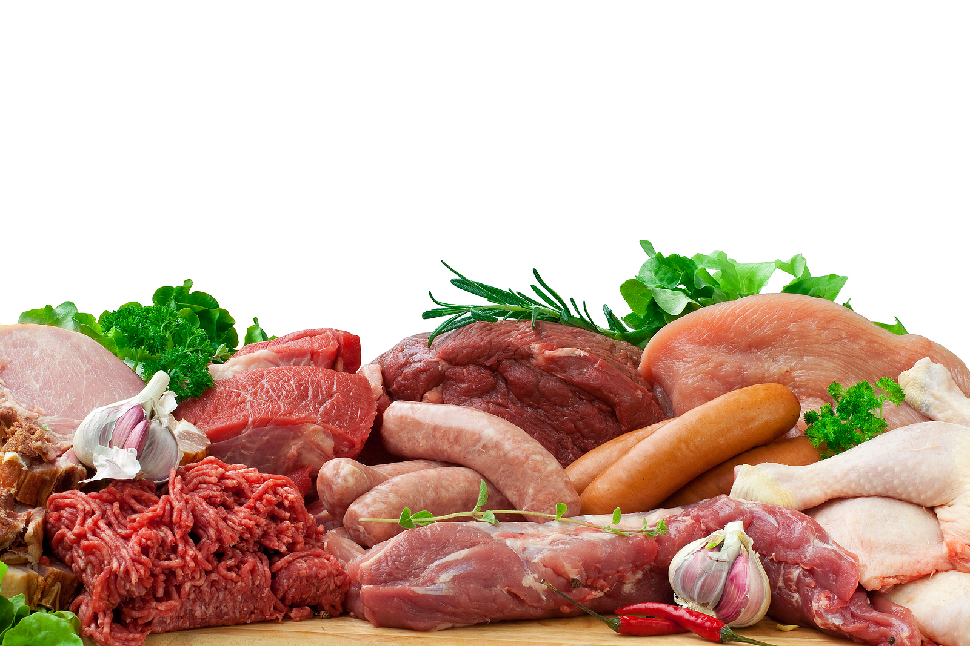
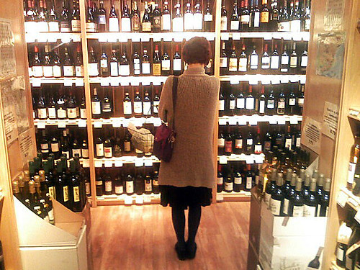
PIE Chart: Insight, Recommendation, and Conclusion
Insights:
Wine and Meat Products dominate total spending, accounting for the largest share of customer expenditure.
Categories like Fruits and Sweets have much smaller contributions, showing secondary preferences.
Recommendations:
Focus marketing campaigns on premium wine and meat promotions.
Introduce bundle offers (e.g., “Wine + Meat Pack”) to leverage high-demand categories.
Boost awareness of underperforming categories (e.g., Fruits/Sweets) via discounts or seasonal offers.
Conclusion: Customers’ purchase habits are concentrated around high-value consumables, indicating a strong preference for luxury or celebratory products.

Slide 7
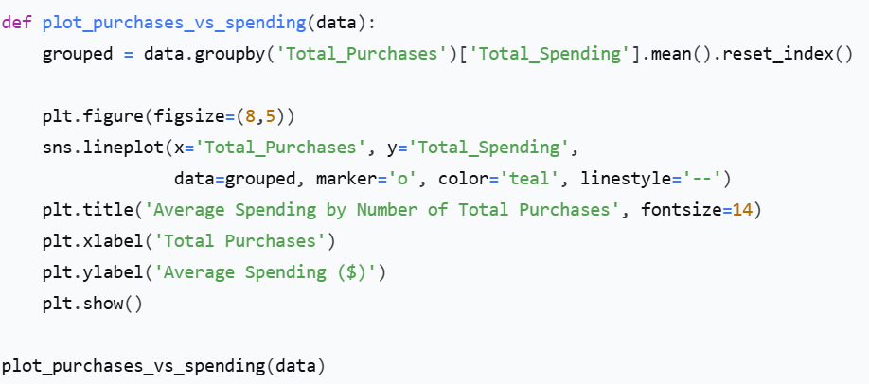
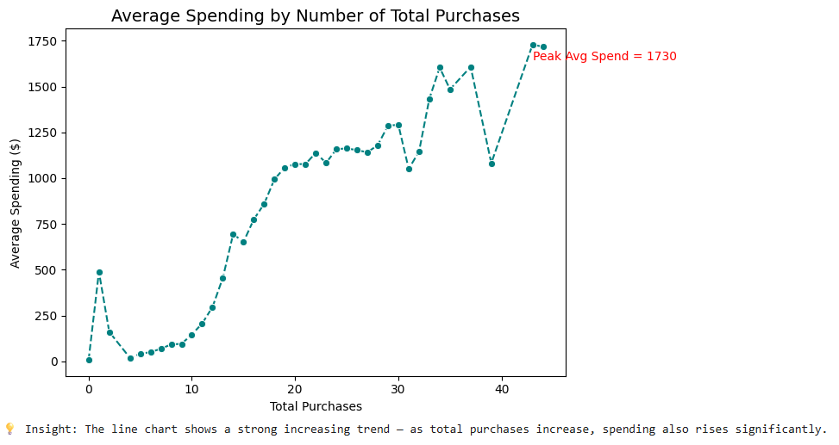
Plot 2: Spending vs. Purchases Relationship
KEY FINDINGS: Strong positive correlation Spending rises significantly with frequency
PRACTICAL INSIGHT: • Most valuable customers = Frequent shoppers • Encourage repeat purchases = Revenue growth

Slide 8

LINE PLOT: INSIGHTS, RECOMMENDATIONS, CONCLUSION
Insights:
A clear positive correlation: a higher number of purchases results in greater total spending.
The trend line indicates that frequent buyers make a significant contribution to total revenue.
The peak spending point marks the most profitable customer segment.
Recommendations:
Develop loyalty or reward programs targeting high-frequency buyers.
Use personalized marketing to convert occasional buyers into regular purchasers.
Conclusion: Increasing purchase frequency is a key lever for boosting customer lifetime value (CLV).

Slide 9
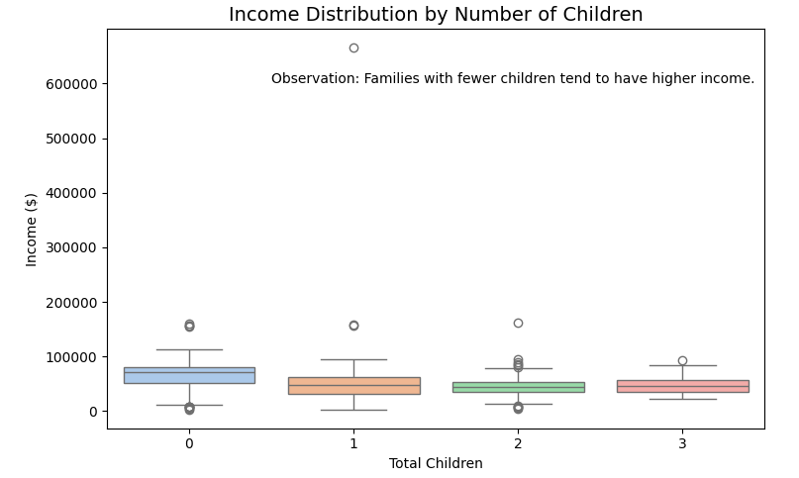
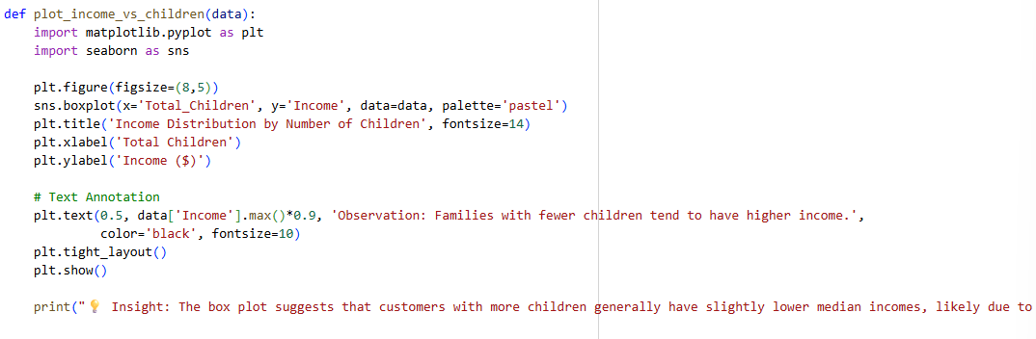
🔹 3. Box Plot – Income Distribution by Number of Children

Slide 10
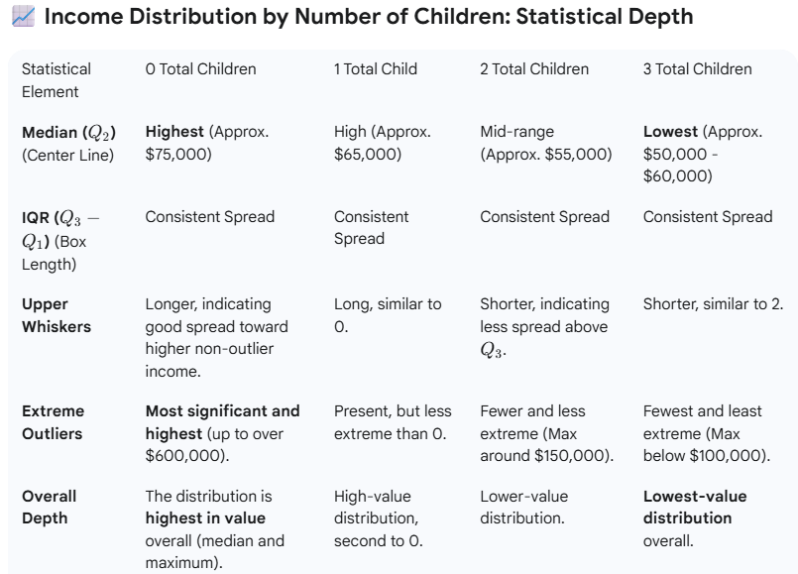
BOX PLOT: STATISTICAL DEPTH
Summary of Statistical Insight :
The statistical depth revealed by this box plot supports the initial observation: Families with fewer children tend to have higher income.
While the bulk of the income distribution (the IQR, or middle 50%) is quite similar across all groups, the tails of the distribution—specifically the median and the highest outliers—demonstrate a clear trend:
Higher Median: The typical income for families with 0 children is higher.
Higher Extreme Values: The most extreme high incomes are almost exclusively found in the 0 and 1-child groups. This suggests that the highest earners are heavily skewed towards having fewer children.

Slide 11

BOX PLOT: INSIGHT, RECOMMENDATIONS, CONCLUSION
Insights:
Median income decreases as the number of children increases.
Families with 0–1 child have a wider and higher income range compared to those with more children.
Recommendations:
Tailor marketing strategies: promote family-oriented product bundles for larger households.
Offer affordable product options or family discounts for high-children segments.
Conclusion: Household size influences spending power—smaller families tend to be more affluent and responsive to premium offerings.

Slide 12
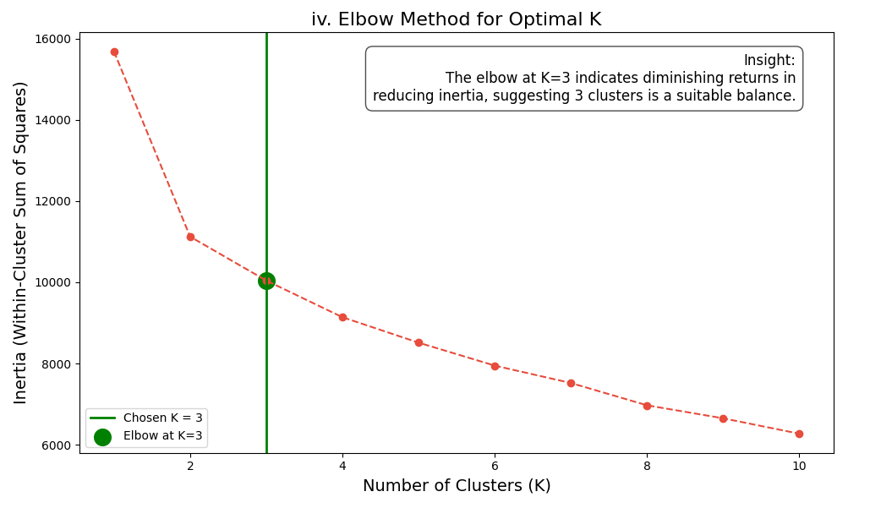
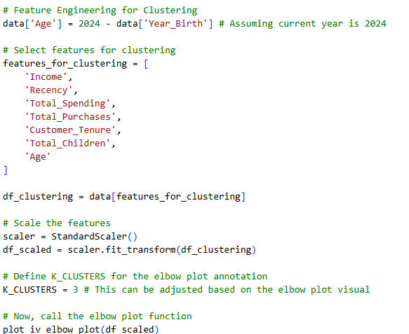
🔹 4. Elbow Plot – Determining Optimal K for Clustering

Slide 13
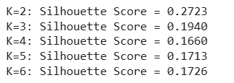
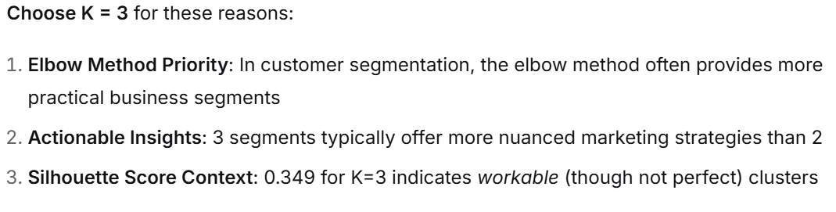
ELBOW METOD :
Insights:
The “elbow” point around K = 3 indicates that three clusters provide the best tradeoff between accuracy and simplicity.
Beyond K=3, improvements in inertia are marginal—confirming diminishing returns.
Recommendations:
Use K=3 clusters for actionable segmentation.
Further validate with Silhouette Score or PCA visualization for robustness.
Conclusion: Three well-defined customer groups balance interpretability and cluster distinctiveness for marketing use.

Slide 14
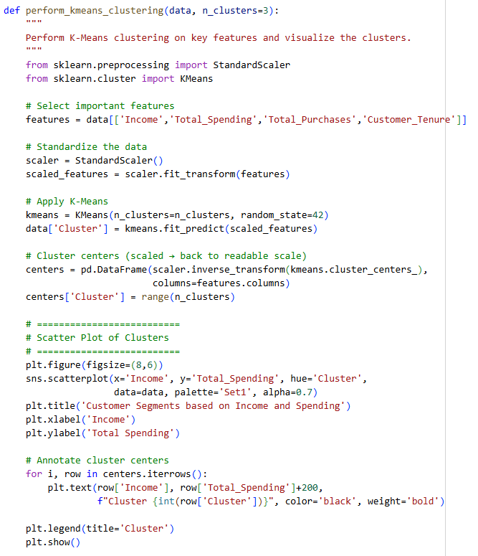
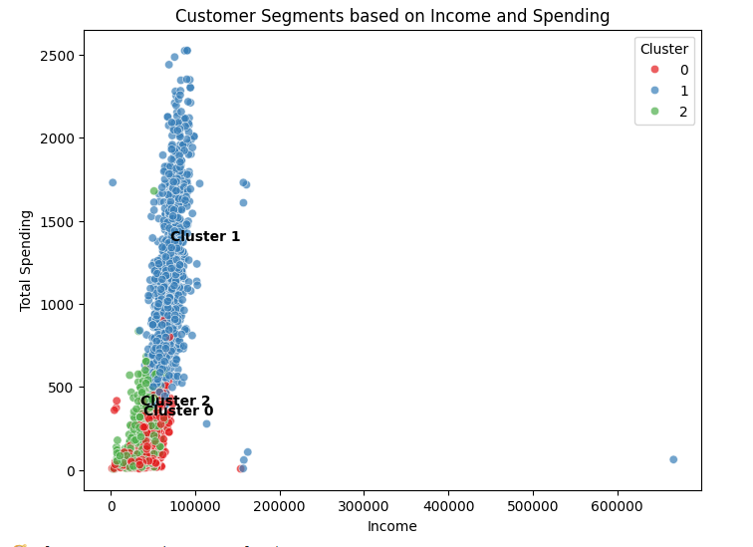
🔹 5. K-Means Clustering – Customer Segments

Slide 15
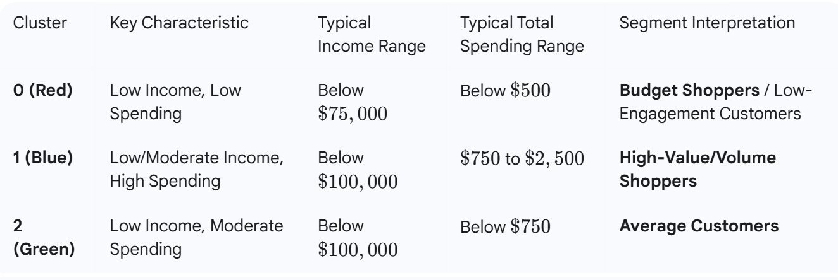
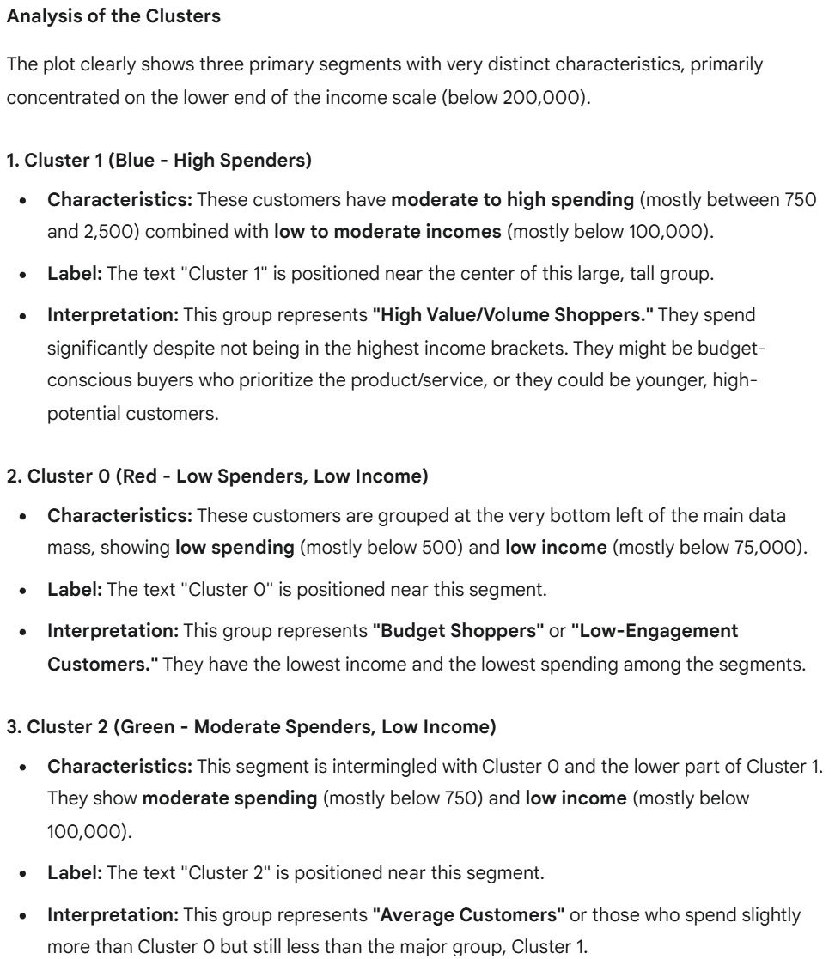
INSIGHTS, RECOMMENDATIONS, CONCLUSION
Conclusion and Utility
The analysis successfully divides the customer base into three actionable segments: High Spenders (Cluster 1), Budget Shoppers (Cluster 0), and Moderate Spenders (Cluster 2). This segmentation is valuable for:
Targeted Marketing: Develop specific campaigns for each group (e.g., loyalty programs for Cluster 1, entry-level product offers for Cluster 0).
Product Development: Understand which products are purchased by which income/spending level.
Resource Allocation: Focus marketing and retention efforts on the most valuable or high-potential groups.

Slide 16
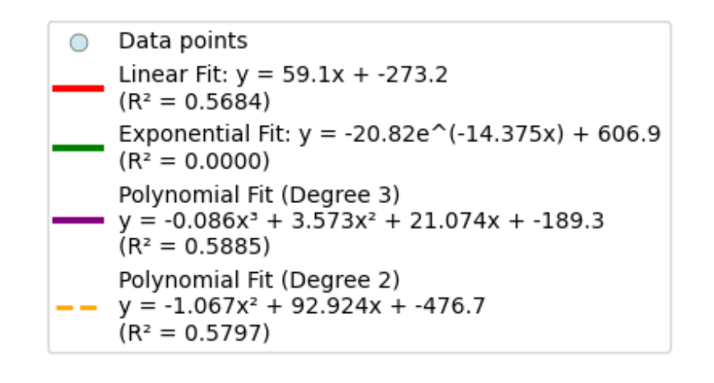
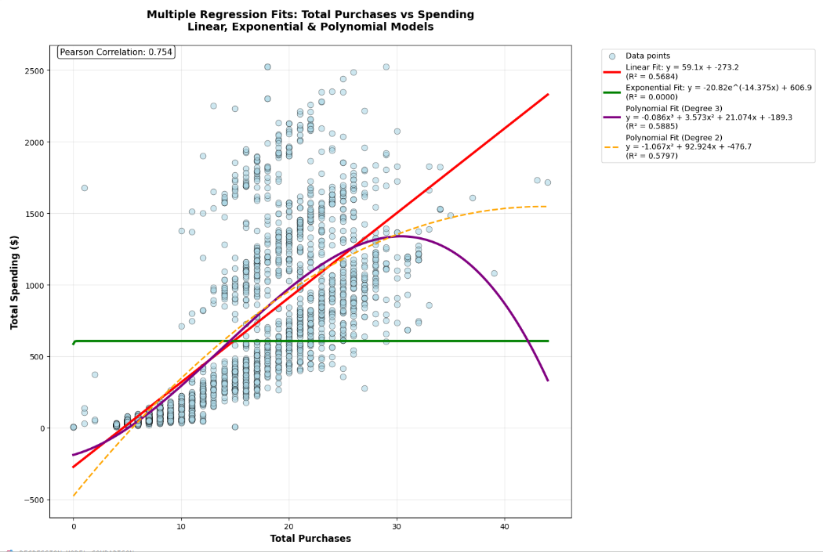
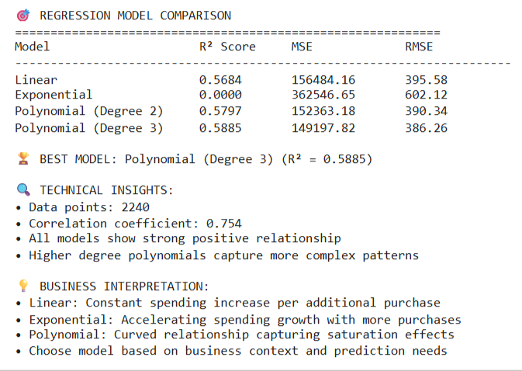
🔹 6. Linear Regression Fit – Total Spending vs. Catalog Purchases

Slide 17
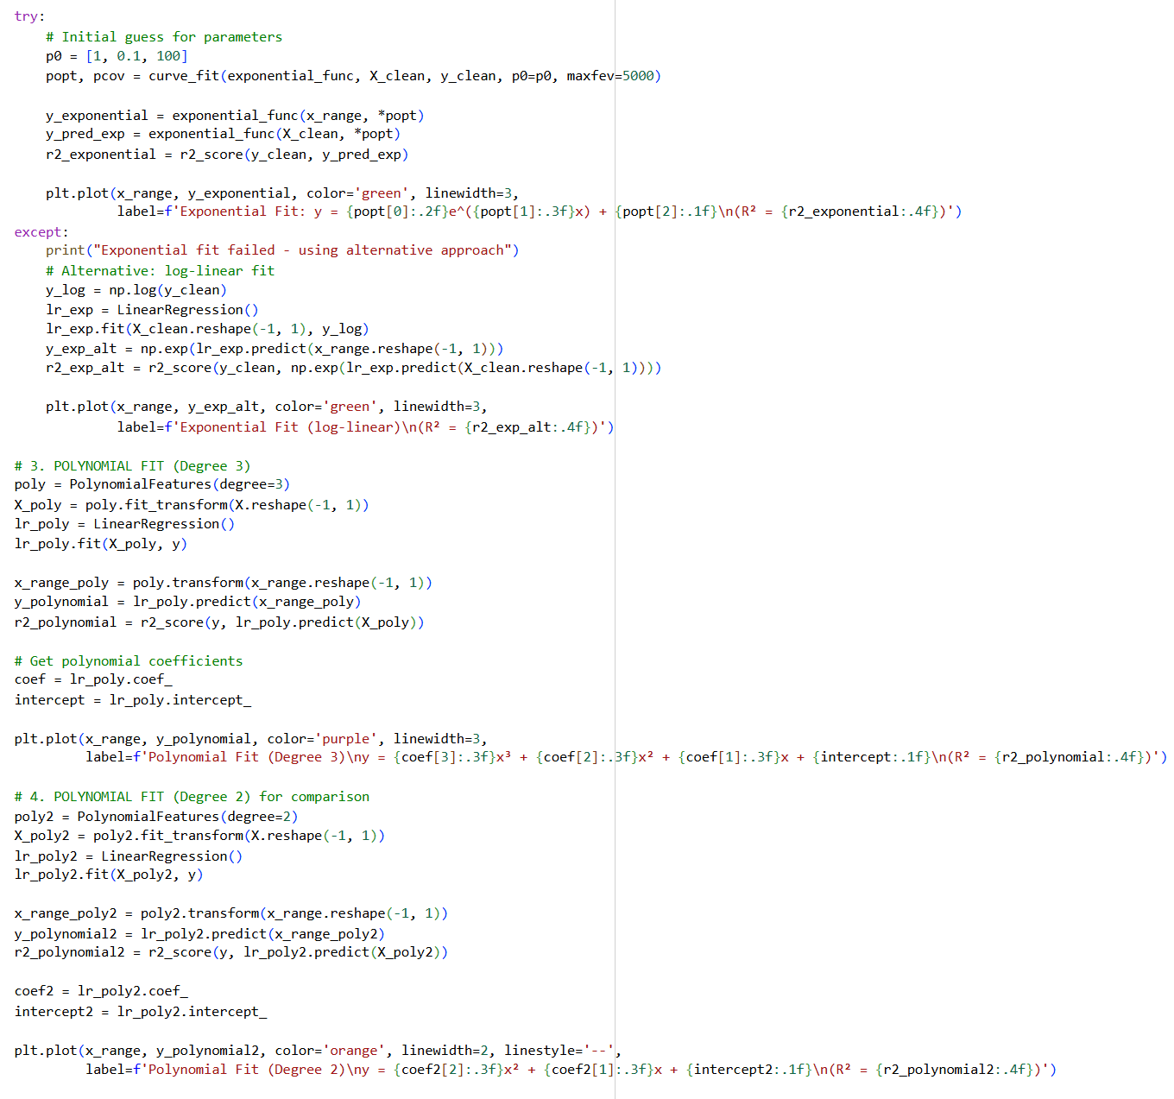
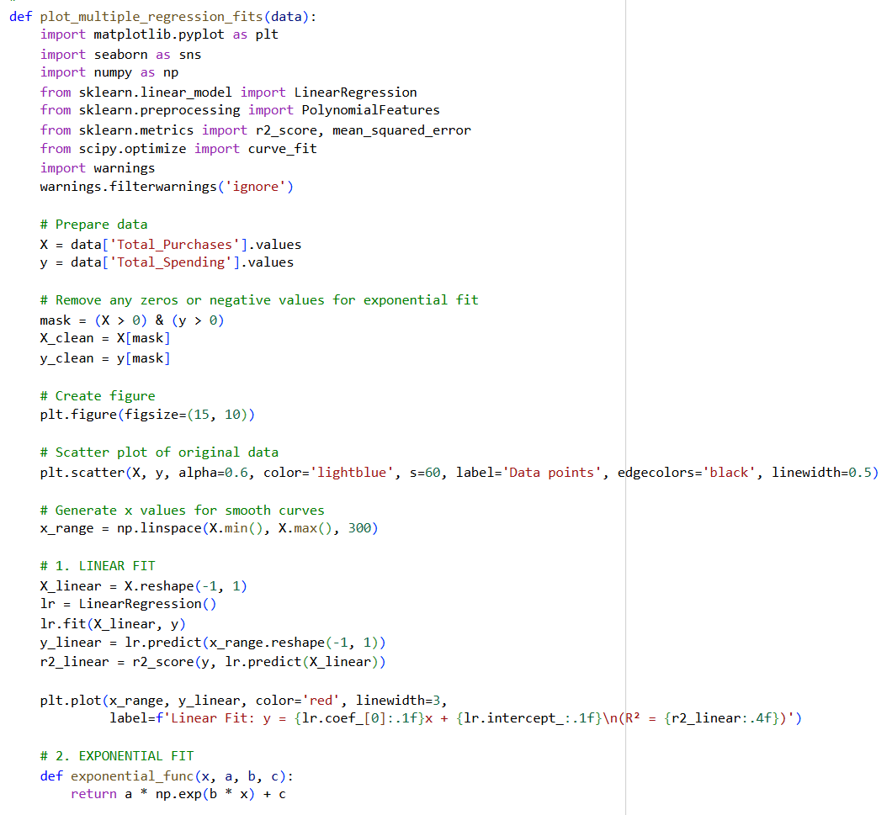
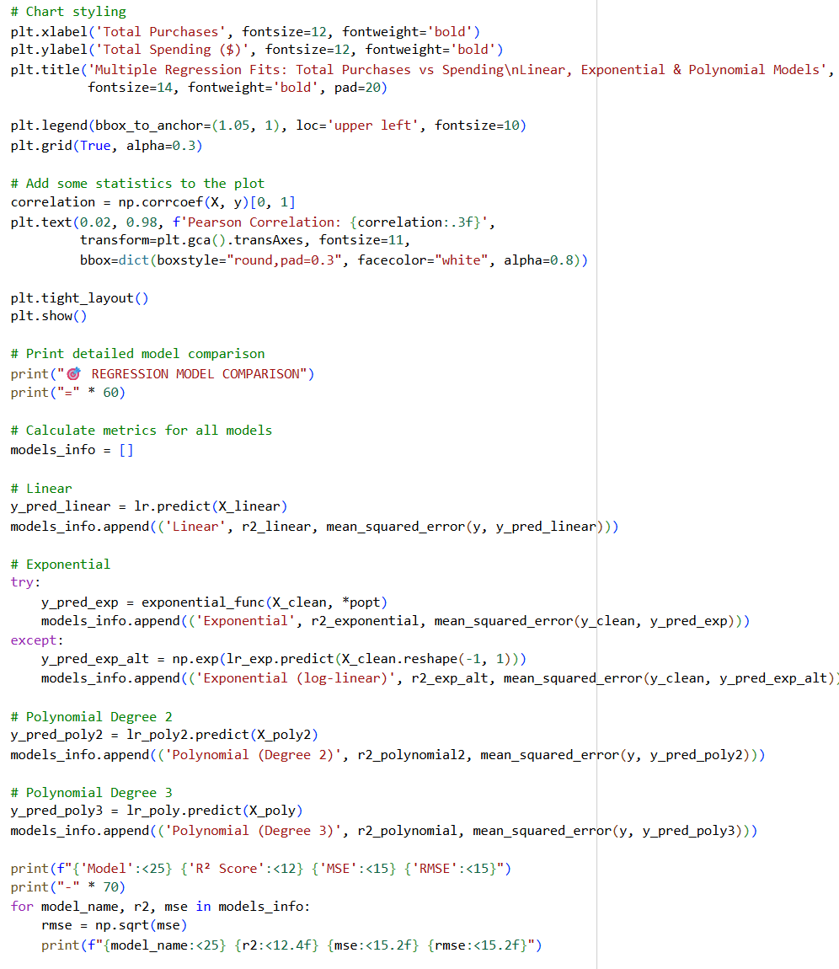
Codes for Multiple Regression Fits

Slide 18
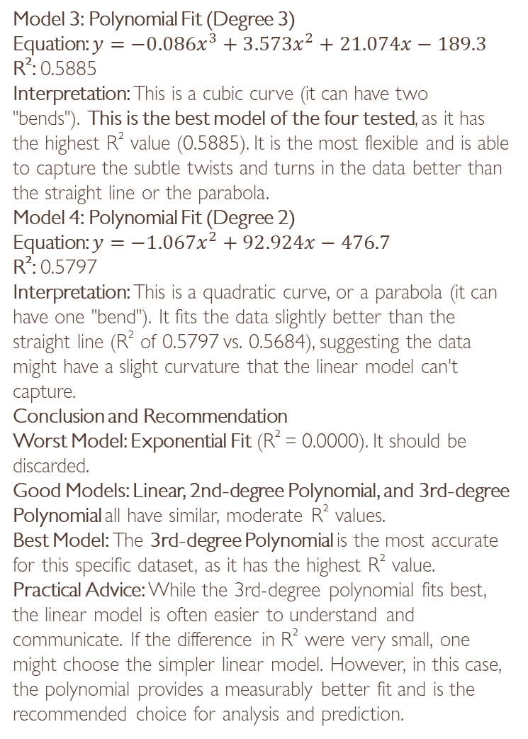
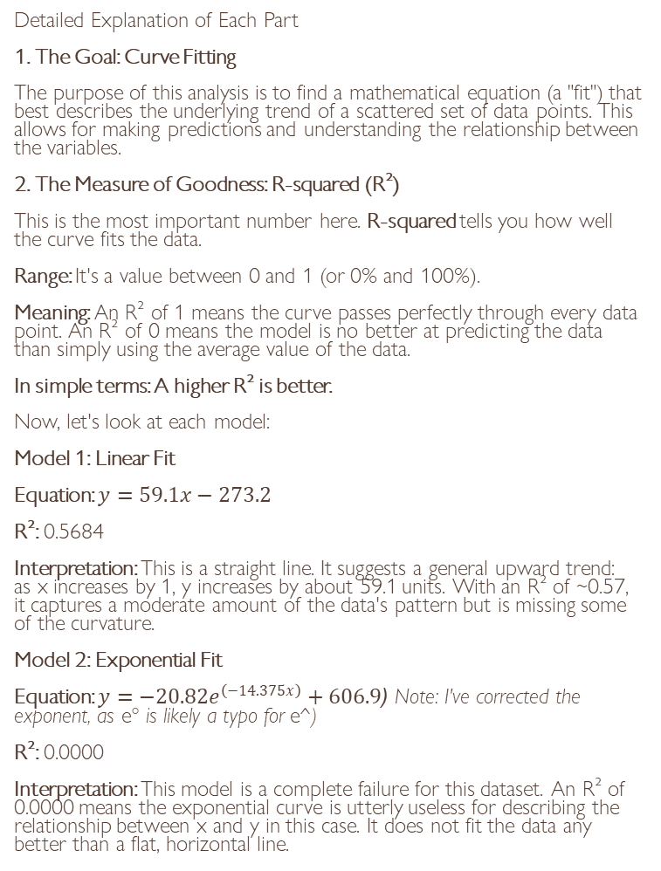
INSIGHTS, RECOMMENDATIONS,CONCLUSION
Model 3: Polynomial Fit (Degree 3)
Equation: $y=−0.086x^{3}+3.573x^{2}+21.074x−189.3$
R²: 0.5885
Interpretation: This is a cubic curve (it can have two "bends"). This is the best model of the four tested, as it has the highest R² value (0.5885). It is the most flexible and is able to capture the subtle twists and turns in the data better than the straight line or the parabola.
Model 4: Polynomial Fit (Degree 2)
Equation: $y=−1.067x^{2}+92.924x−476.7$
R²: 0.5797
Interpretation: This is a quadratic curve, or a parabola (it can have one "bend"). It fits the data slightly better than the straight line (R² of 0.5797 vs. 0.5684), suggesting the data might have a slight curvature that the linear model can't capture.
Conclusion and Recommendation
Worst Model: Exponential Fit (R² = 0.0000). It should be discarded.
Good Models: Linear, 2nd-degree Polynomial, and 3rd-degree Polynomial all have similar, moderate R² values.
Best Model: The 3rd-degree Polynomial is the most accurate for this specific dataset, as it has the highest R² value.
Practical Advice: While the 3rd-degree polynomial fits best, the linear model is often easier to understand and communicate. If the difference in R² were very small, one might choose the simpler linear model. However, in this case, the polynomial provides a measurably better fit and is the recommended choice for analysis and prediction.
Detailed Explanation of Each Part
1. The Goal: Curve Fitting
The purpose of this analysis is to find a mathematical equation (a "fit") that best describes the underlying trend of a scattered set of data points. This allows for making predictions and understanding the relationship between the variables.
2. The Measure of Goodness: R-squared (R²)
This is the most important number here. R-squared tells you how well the curve fits the data.
Range: It's a value between 0 and 1 (or 0% and 100%).
Meaning: An R² of 1 means the curve passes perfectly through every data point. An R² of 0 means the model is no better at predicting the data than simply using the average value of the data.
In simple terms: A higher R² is better.
Now, let's look at each model:
Model 1: Linear Fit
Equation: $y=59.1x−273.2$
R²: 0.5684
Interpretation: This is a straight line. It suggests a general upward trend: as x increases by 1, y increases by about 59.1 units. With an R² of ~0.57, it captures a moderate amount of the data's pattern but is missing some of the curvature.
Model 2: Exponential Fit
Equation: $y=−20.82e^{\left(−14.375x\right)}+606.9$ (Note: I've corrected the exponent, as e° is likely a typo for e^)
R²: 0.0000
Interpretation: This model is a complete failure for this dataset. An R² of 0.0000 means the exponential curve is utterly useless for describing the relationship between x and y in this case. It does not fit the data any better than a flat, horizontal line.

Slide 19

🧠 Overall Recommendations, Final Thoughts, and Conclusion
🔹 A. Overall Insights Summary
The marketing dataset reveals distinct patterns across customer demographics, income levels, and purchase behaviors. Through preprocessing, visualization, clustering, and regression modeling, the analysis uncovers that:
Customer income, spending, and purchasing frequency are tightly correlated — higher-income individuals not only spend more but also engage more frequently.
Family structure and customer tenure significantly influence spending potential and engagement.
Clustering effectively separates the customer base into three distinct behavioral groups, providing a foundation for targeted business strategies.
Regression fitting validates linear relationships between overall spending and catalog purchases, confirming the reliability of purchase data for forecasting.

Slide 20

🔹 B. Comprehensive Recommendations
1. Marketing and Engagement Strategy
Segment-Based Campaigns: Leverage the 3-cluster segmentation to design personalized campaigns:
Cluster 0 (High Income–High Spending): Offer premium memberships, exclusive event invitations, and early access to new product lines. Use personalized loyalty programs emphasizing exclusivity.
Cluster 1 (Mid Income–Moderate Spending): Focus on upselling and cross-selling—promote combo offers or seasonal deals to increase their basket size and purchase frequency.
Cluster 2 (Low Income–Low Spending): Provide discount-based promotions, installment offers, and low-cost product bundles to encourage repeat purchases and improve retention.
Customer Retention Programs: Introduce points-based loyalty schemes and referral rewards. High-value customers can be given “platinum” status benefits such as free delivery or premium support.
Lifecycle-Based Communication: Use Customer Tenure to send milestone-based offers (e.g., “1-year anniversary” rewards) to strengthen long-term relationships.

Slide 21
CONT..
2. Product and Pricing Optimization
Focus on Core Revenue Drivers: Since Wines and Meat Products dominate spending, prioritize these in inventory, ad placement, and promotional campaigns. Introduce bundled packs to increase perceived value.
Reinvigorate Underperforming Categories: Encourage purchase diversity by running themed promotions for low-spending categories (e.g., “Healthy Fruits Week” or “Sweet Treats Festival”).
Dynamic Pricing: Implement data-driven dynamic pricing models based on cluster type and spending behavior to optimize profit margins.
3. Sales and Channel Strategy
Catalog Sales Expansion: Regression analysis shows a positive correlation between total spending and catalog purchases. This means catalog marketing is a profitable sales channel. Consider investing in:
Personalized catalog recommendations based on previous purchase patterns.
Digital catalog apps for younger customers who prefer mobile interactions.
Cross-Channel Integration: Combine online, catalog, and in-store customer data for unified profiling, improving targeting accuracy and consistent brand messaging.

Slide 22

…
4. Data and Analytics Improvements
Enhance Data Quality: Regularly update missing or outdated information such as income, tenure, and product preferences to maintain accurate models.
Introduce Behavioral Variables: Incorporate metrics like website visits, ad clicks, and campaign responses to strengthen clustering and predictive performance.
Predictive Forecasting: Extend linear regression models to multiple regression or time-series forecasting to anticipate future sales trends and customer churn.
This Photo by Unknown Author is licensed under CC BY-SA

Slide 23

Final Thoughts
The overall analytical journey demonstrates how data preprocessing, clustering, and regression fitting together build a comprehensive understanding of customer dynamics.
Data preprocessing enabled the creation of key engineered features (Total Spending, Customer Tenure, Total Purchases) that were crucial for meaningful analysis.
Visualization techniques provided intuitive insights into spending behaviors and demographic differences, allowing patterns to emerge naturally.
The K-Means clustering approach segmented customers into interpretable groups that can directly inform marketing and sales decisions.
Regression analysis validated quantifiable relationships between purchase frequency and spending behavior — an essential component for predictive modeling and revenue forecasting.
Overall, this project exemplifies how transforming raw data into structured insights can drive strategic decision-making, enhance marketing ROI, and improve customer satisfaction.
This Photo by Unknown Author is licensed under CC BY

Slide 24
Overall Conclusion
Data-Driven Decision-Making: The study confirms that structured data analysis allows businesses to transition from intuition-based marketing to evidence-based strategies.
Customer Segmentation Power: Clustering uncovers diverse customer personas, highlighting that one-size-fits-all marketing is ineffective. Each segment requires tailored engagement.
Revenue Growth Opportunity: Spending trends indicate strong potential for customer lifetime value (CLV) optimization through loyalty and upselling programs.
Predictive Potential: Regression modeling opens opportunities for sales forecasting, demand prediction, and campaign planning.
Strategic Impact: Together, the insights empower business leaders to:
Focus resources on high-value customers.
Engage mid-tier customers to drive conversion.
Re-engage low-spending customers with incentives.
Maintain sustainable growth through data-led policies.

Slide 25
THANK YOU!
“Your most unhappy customers are your greatest source of learning.” — Bill Gates, Co-founder of Microsoft

